Slide 1

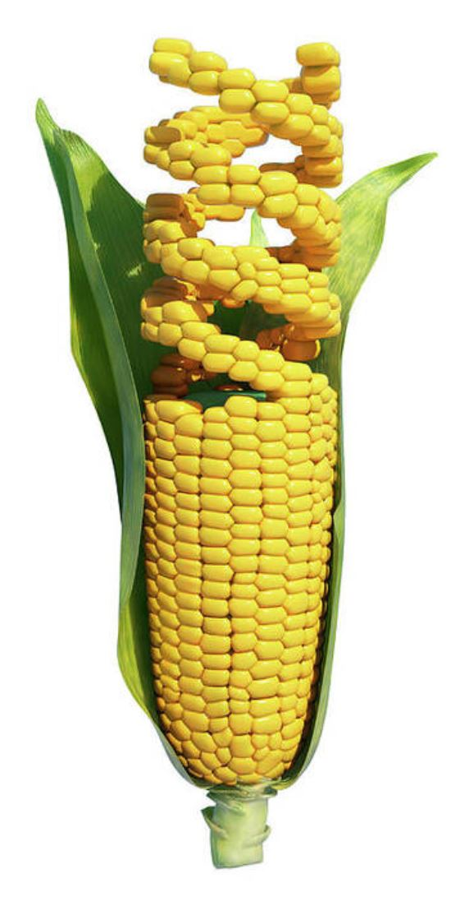

Brandon Webster PhD Student Plant Breeding and Genetics
Cloud Computing Fellowship –
Cloud database for plant breeding

Slide 2
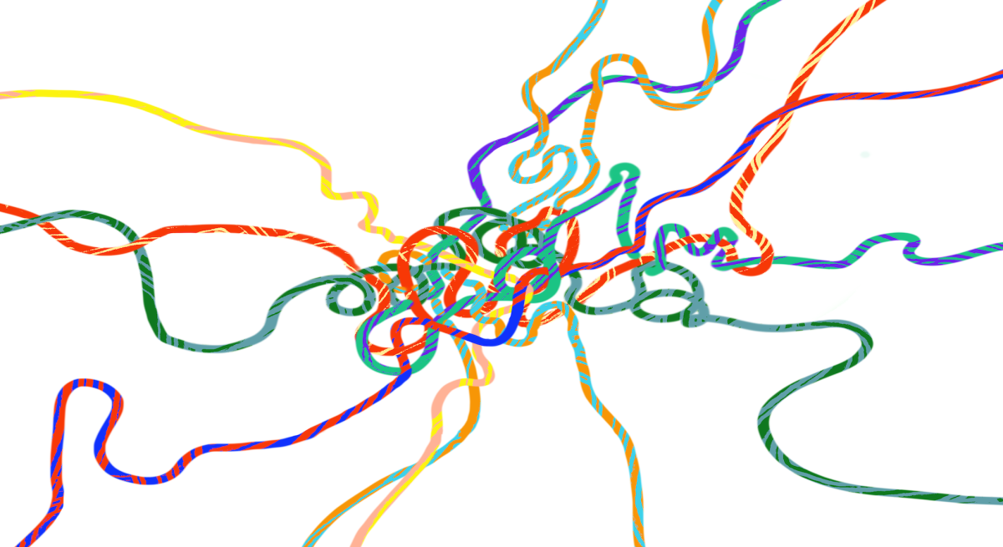
The Problem – Data Discordance
Multiple streams of data collected at different scales
Remote Sensing
Gene expression
Plant physiology
DNA Sequence variation
Collaborators working on different versions of the data

Slide 3
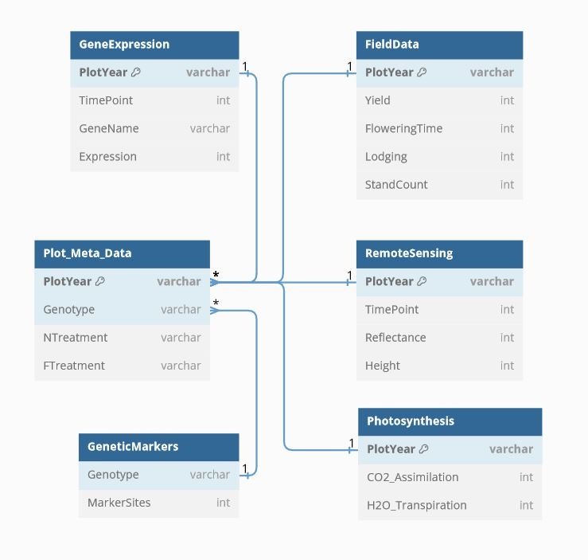
Data Unity – PostreSQL Database on Azure
Justification:
- Separate data storage from analysis
- Increase uniformity of data
- Reduce number of files
- Hosted on cloud services
- Scale to meet demands of group (up or down)
- Reduce server administration duties (updating, patching, repairing)
Expected result: Increased tractability and ease of collaboration for research groups

Slide 4
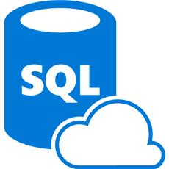


Implementing the solution – the plan
Create PostgreSQL database through Azure web portal
Use sqlAlchemy and pandas to upload csv’s to sql tables
Use sqlAlchemy and pandas to query database.
Data storage
Data Transfer
Data analysis and modelling

Slide 5
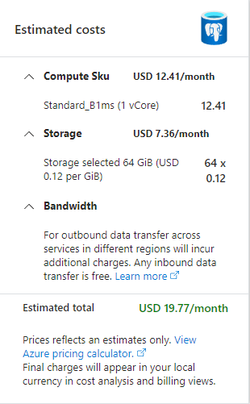
1. Create PostgreSQL database through Azure web portal
Multiple ways to create PostgreSQL DB.
Azure Database for PostgreSQL Flexible Server
Cheapest, simplest, most adaptable for our needs
Can be turned on or off
Burstable compute(1 vcore, 64 GB storage)
Before connecting from Python, networking permissions need to be changed.
Azure web portal -> Networking -->
-> Create new firewall rule to allow IP address.
Your IP address here

Slide 6
2. Use sqlAlchemy and pandas to upload csv’s to sql tables
Prepare data load, into Pandas
Create sqlAlchemy ‘engine’ object
Connects to PostgreSQL with username, password, server address, port, and database name
Use Pandas ‘dataframe.to_sql()’ with engine object to upload data to cloud
Data storage
Data Transfer
Data analysis and modelling

Slide 7
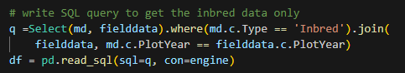
3. Use sqlAlchemy and pandas to query database.
Pandas.read_sql() takes a query and engine object
Create sqlAlchemy ‘engine’ object
Query needs to be constructed
Initiate ‘Table’ object
Write query with Select().where().join() functions
Example query to select only inbred maize genotypes from md and join with field data
Data storage
Data Transfer
Data analysis and modelling

Slide 8
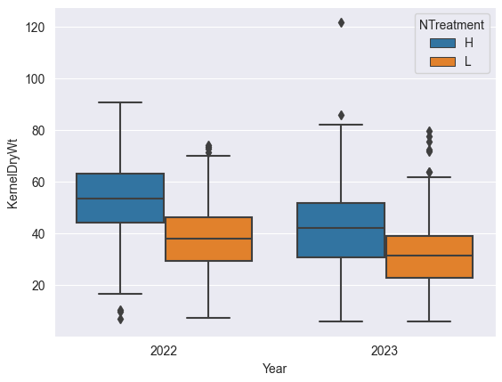
Checking data from query – Quality Control
Visualization of data from query appears to match what we expect.
Kernel weight in grams from 1092 inbred plots grown in 2022 and 2023.
Feel confident running analysis

Slide 9

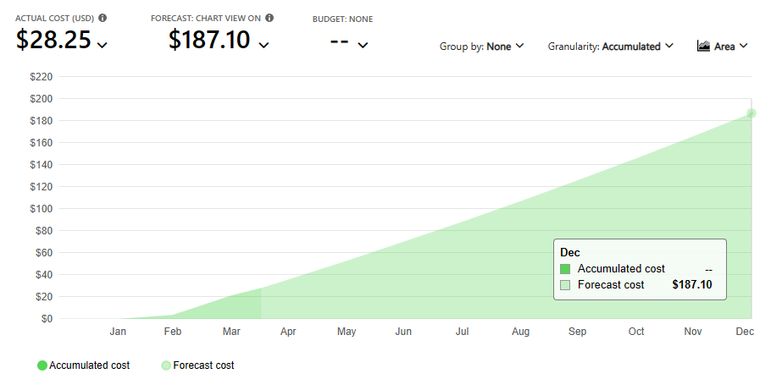
Cost to run and operate server
Forecasted cost for lowest compute tier are about $200 /yr based on 2 months usage

Slide 10
Outcomes
Database engineering could be productive skill in plant breeding lab.
Time spent preparing data for SQL
Separation of meta data from measured traits
Standardization of measurements (what unit, how many days after planting, etc)
SQL querying could be bottleneck in terms of collaboration
Skill transfer improving data storage in the lab already even though we probably won’t make the jump to a cloud-based database yet.

